Slide 1


MomCare
Global Innovation Hub peer-to-peer session: segmentation
Julie Fleischer – April 26th , 2023

Slide 2
Today
Introduction
Outcomes & Barriers
Vision
MomCare program overview
Segmentation
Groups
Low-risk
High-risk
Teenage
Risk of perinatal depression
Next steps

Slide 3



Maternal and neonatal health is a critical area of need in Africa with a high mortality rate and several challenges to realizing universal healthcare
High Maternal and Neonatal Mortality¹
# of maternal deaths per 100,000 live births
# of death neonates per 1,000 live births
Kenya
Tanzania
US
NL
Kenya
Tanzania
US
NL
Challenges to Realize Universal Healthcare²
Healthcare Quality
Infrastructure
Data Systems
Affordability
Political Instability
3
Source: 1. CIA Factbook, 2.Performance assessment of the county healthcare systems in Kenya: a mixed-methods analysis, BMJ Global Health 2021
Notes:
https://gh.bmj.com/content/bmjgh/6/6/e004707.full.pdf https://documents1.worldbank.org/curated/en/260981468150303844/pdf/541060BRI0RBF110Box345636B01PUBLIC1.pdf
?Add more specific example
In Kenya
Working towards UHC, however significant gaps in access and affordability for out of pocket costs remain
Private health insurance remains low overall, with significant discrepancy seen across the spectrum of urbanization and wealth
Kenya National Bureau of Statistics – demographic and health survey 2022
One in four persons in Kenya (26% of females and 27% of males) have some form of health insurance.
The National Hospital Insurance Fund is the most common type of health insurance (24% each of females and males).
The proportion of persons covered with any health insurance is higher in urban areas (39% among females and 41% among males) than in rural areas (20% among females and 19% among males).
Health insurance coverage increases with increasing wealth, from 5% among females and males in the lowest wealth quintile to 56% among females and 60% among males in the highest wealth quintile.
98% response rate from 42000+ households
The percentage of women with four or more ANC visits for their last live birth is higher in urban areas (74%) than in rural areas (62%).

Slide 4

In (maternity) care in LMICs, there are several behavioral, organizational, and financial barriers affecting both women and healthcare providers
Barriers | Women | Healthcare providers
Behavioral | Low education and awareness levels Late start of the pregnancy journey Wary of stigma and taboo Don’t feel empowered | Limited knowledge on mental health issues Overburdened staff Attitude
Organizational | Difficult to navigate fragmented healthcare system Hard to reach a clinic | Low perceived quality Frequent stock-outs Broken or missing equipment High staff turnover & staff shortage Limited digitization and digital skills
Financial | High opportunity cost High risk of catastrophic expenditure | Late and insufficient payments by insurers and the government Very limited transparency
4

Slide 5
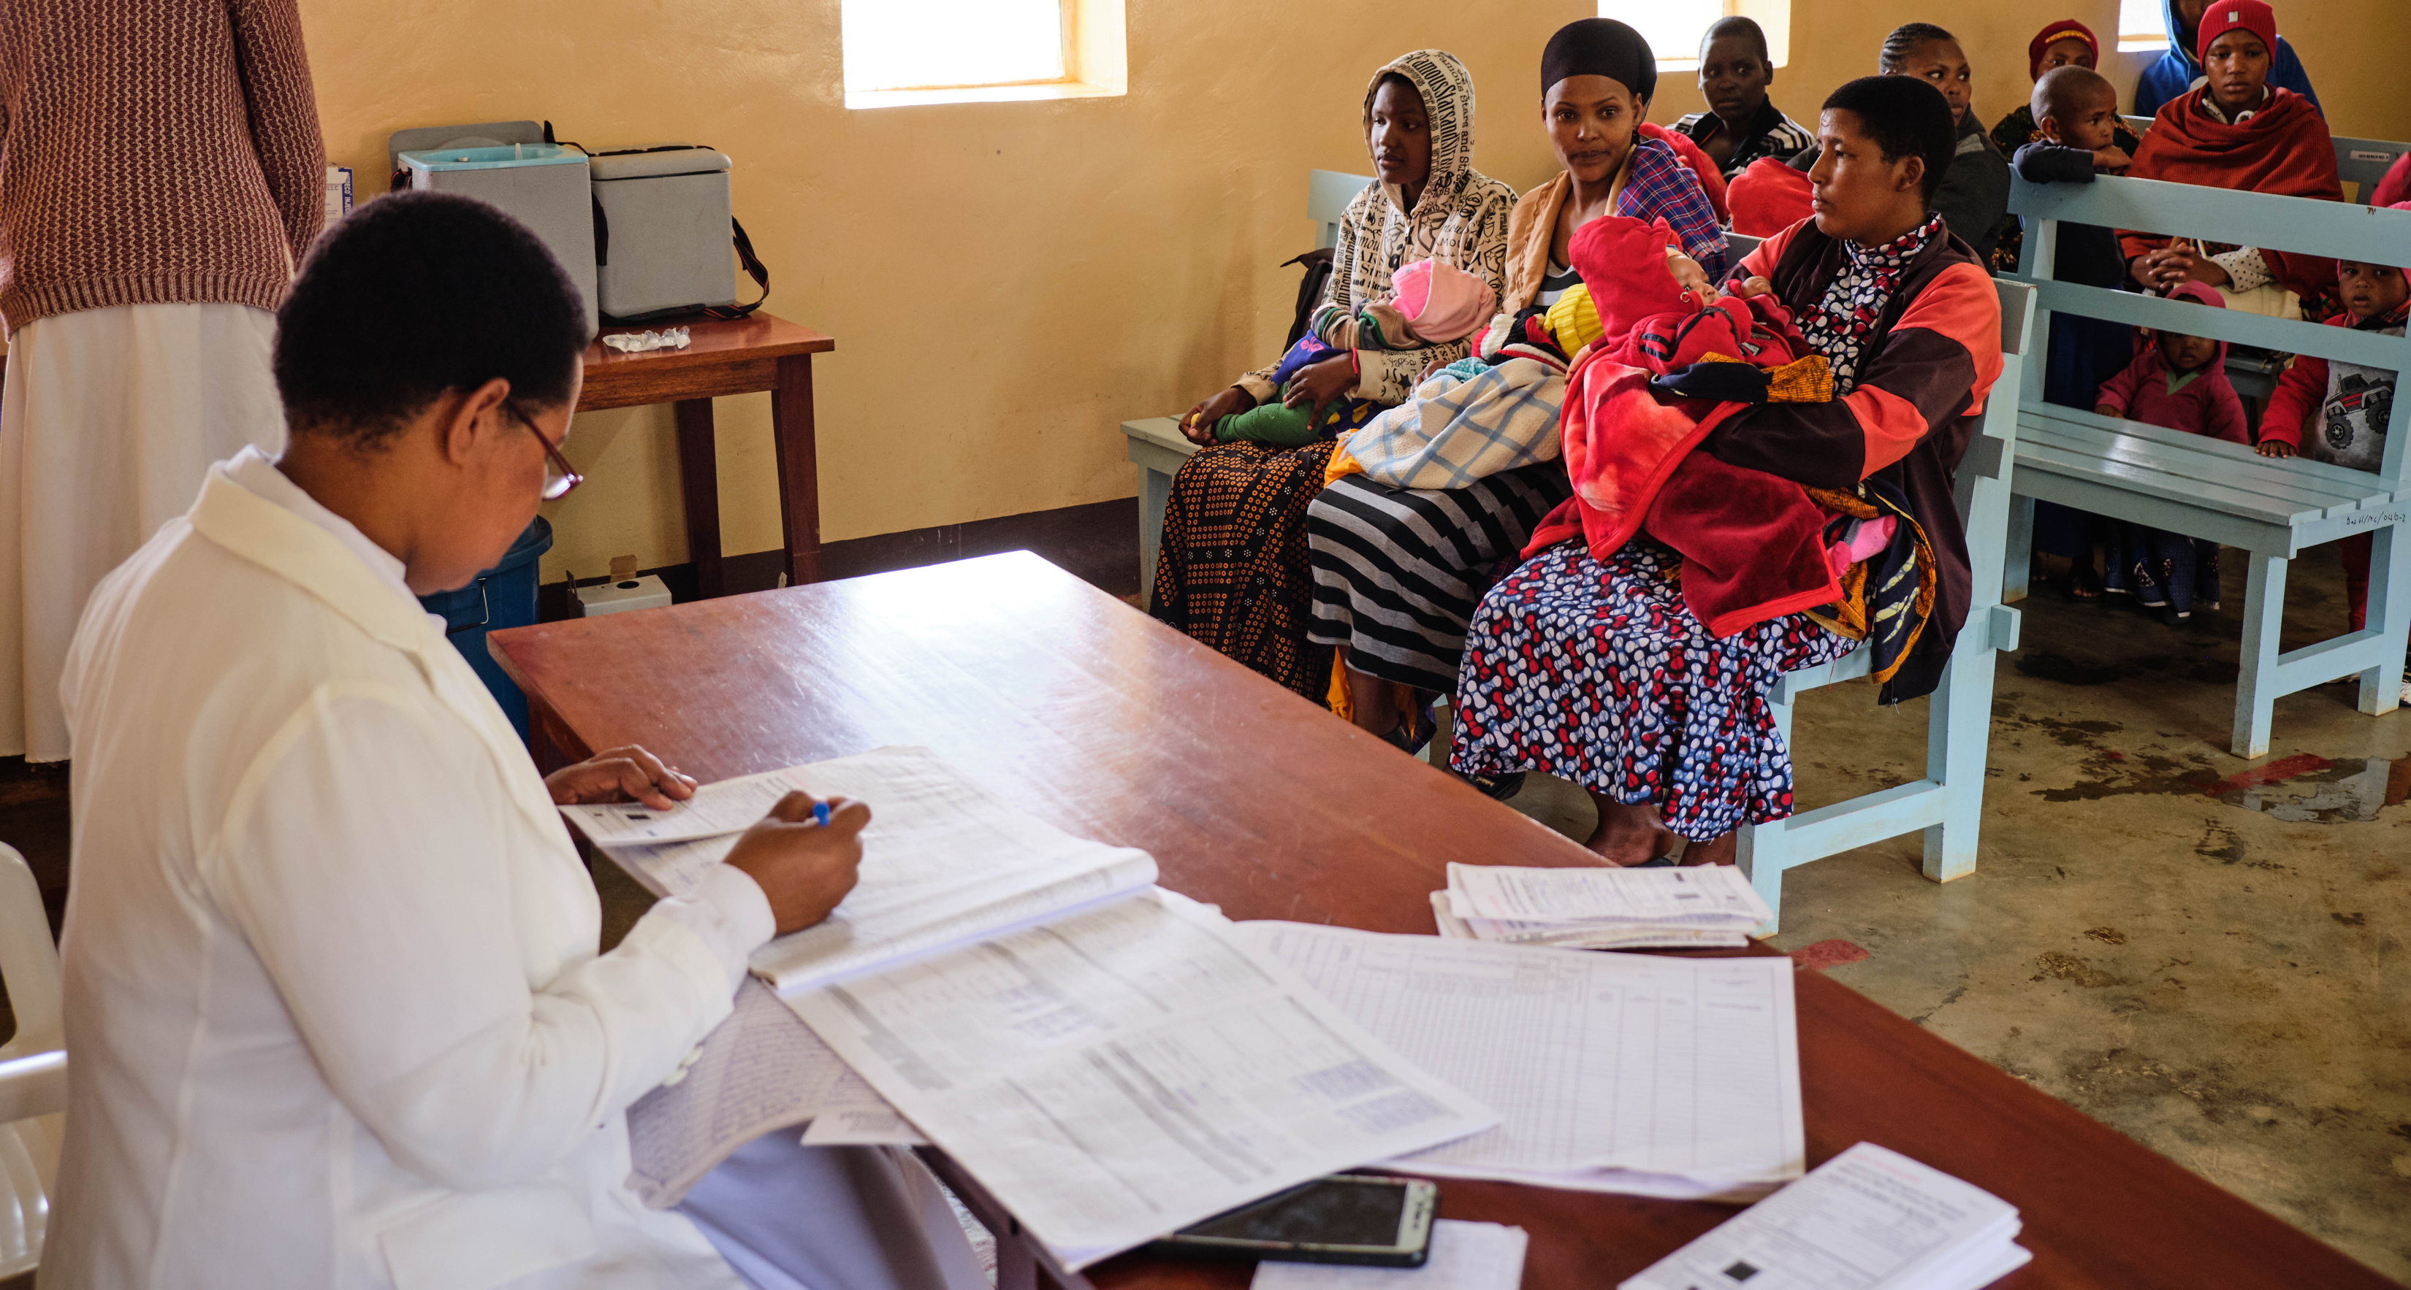
Notes:
Perfect example of paper-based clinical admin when we see that this doctor / nurse actually owns her own smartphone

Slide 6
get better outcomes
through
smarter financing, improved measurement and patient-centered care delivery
by
demonstrating how digitization and connectivity can do for healthcare what is has done for the consumer market
Notes:
Perfect example of paper-based clinical admin when we see that this doctor / nurse actually owns her own smartphone

Slide 7
MomCare Overview
Components | Results
7

Slide 8






MomCare iteratively improves financing and care delivery across regions based on the priorities of the local healthcare ecosystem and needs of the stakeholders
Kenya
53M population
39% of population < 14
29% < poverty line
65 live births / 1000 teenagers
75% internet penetration
20% is insured
Government committed to UHC and willing to work with private sector
Tanzania
64M population
44.8% of population < 14
45 % < poverty line
124 live births / 1000 teenagers
49% internet penetration
15% insured (~25% on iCHF)
>60% public healthcare
Heavily relies on external funding & OOP spending
 | KENYA - Kisumu | KENYA - Nairobi | TANZANIA - Manyara
> 28 K journeys
since 2017
> 28 K journeys
since 2019

Slide 9





MomCare is a care bundle powered by mobile communication, quality support, and innovative financing features
Done
A care bundle:
“A set of interventions that – used together – significantly improves health outcomes”
Key principles of digital development
Focusing on patient outcomes
Starting with a minimum viable product, using a progressive development approach over time
Using evidence from data to prioritize and shape the development path
Quality support
SafeCare standards
Trainings & workshops
Network management
Journey tracking
Transparency on quality
Behavioral nudges
Analytics & research capabilities
Quality & Access
Clinical
Experience
Economic
Mobile wallet
Financial coverage
Conditional payments for providers (“smart contracts”)
Timely payments
9

Slide 10
MomCare is a cohort-based VBC program that allows for iterative improvements
1 | Organize care into integrated practice units | Include complications in pregnancy journey | Ambulance (temporary) | Data disseminations to align within clinics | Mental health intervention
2 | Measure outcomes and cost for every patient | MTIBA billing data | SMS | End-of-journey calls | Custom web-app
3 | Reimburse through bundled payments for full care cycles | Standard journey | Extending enrollment period | Adding bonus payments | ValuePoints
4 | Integrate care across different facilities | Hub & spoke model | Referrals
5 | Expand services with the best outcomes across geography | Nairobi | Rural Kenya (Kisumu) | Manyara Tanzania | Hanang
6 | Create IT platform | Patient Journey App for provider engagement | Chain of Trust for data collection and provider engagement | Dashboards | Open data platform

Slide 11
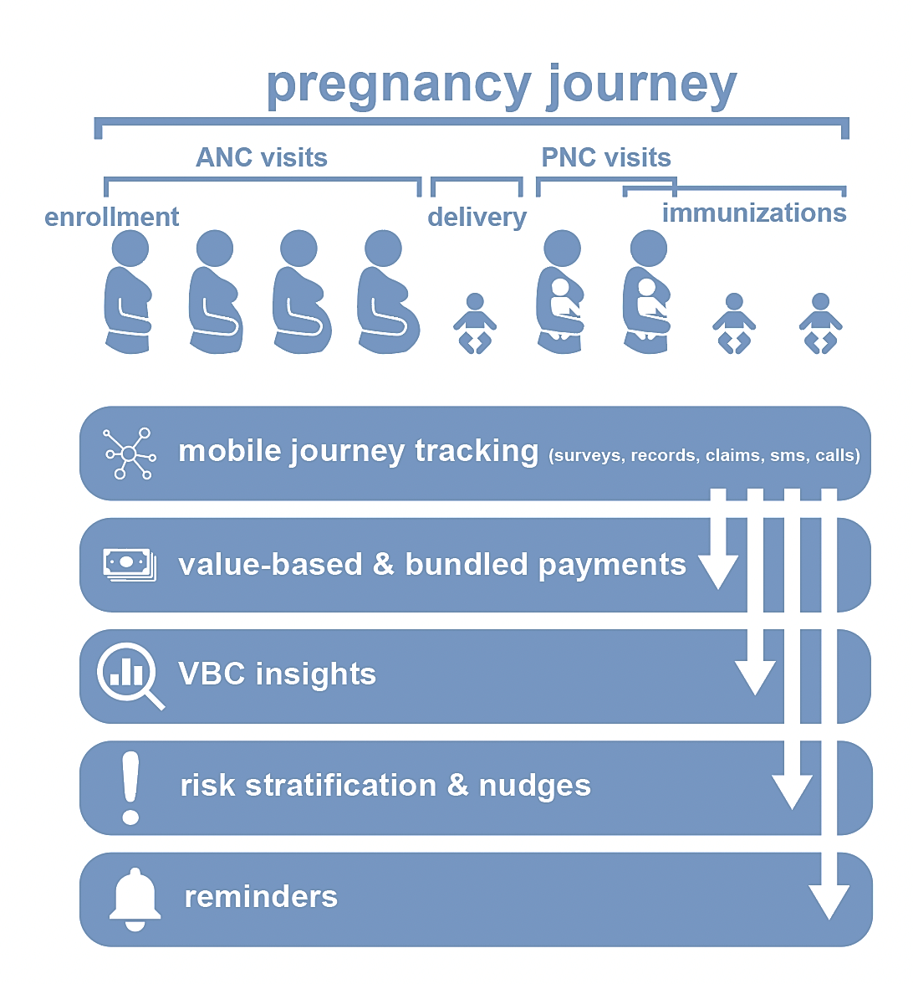
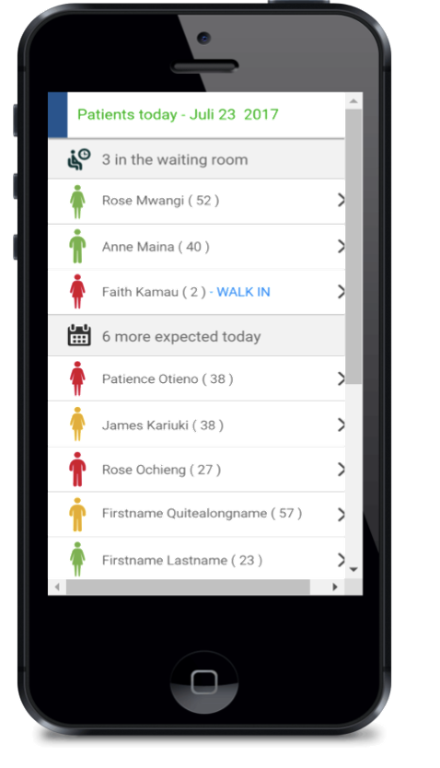

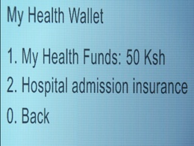
MomCare ‘mobile journey tracking’ capability covering the complete journey supports the key components of MomCare
Care Bundle | Payments | Insights | Nudges
Patient tracker for providers
Showing treatment information and improvement suggestions over patients
Health wallet for patients
Showing entitlements and prompting alerts for clinic appointments

Slide 12
MomCare implements innovative financing mechanisms gradually moving from fee-for-service to value-based care models
Care Bundle | Payments | Insights | Nudges
VALUE-BASED CARE CONTINUUM
In Cohort 19, we will combine bundled payments and value-based (bonus) payments
Cohort 13 - 14
Introduced bundled payments
Cohort 1
Basic care
Cohort 4 - 12
Basic care + complications + referral + conditional quality bonus to providers + patient incentives
Cohort 15 - 18
Introduced capitation (single payment per patient)
Cohorts 2 - 3
Basic care + complications
Fee for Service (FFS)
Pay for each individual service
Incentivizes volume increase at providers
Incentivizes cherry-picking high-risk patients
Not linked to quality
FFS - Pay for Performance Hybrid
Pay for each individual service
Incentivizes volume increase at providers
Incentivizes cherry-picking high-risk patients
Incentivizes quality
Bundled payments
Pay for a pre-defined set of services
Simplifies billing
Incentivizes quality
Incentivizes provider accountability
Shared savings/risks
Strongest focus on good outcomes
Operational flexibility for healthcare providers
12

Slide 13

We observe improved adherence to ANC care as the clinics continue to participate in the program
Data from cohort 1 – cohort 14
Pregnancy journey (PJ) ANC adherence and % of PJs with ANC profile* over time
*refers to a set of laboratory tests performed during pregnancy including Hb, syphilis, HIV, blood glucose, urine, TB tests
+16%
Average # of ANC visits
%of PJs with ANC profile
3,5
3,2
3,1
3,2
3,0
3,0
3,0
2,9
2,9
90%
84%
+15%
75%
75%
77%
73%
70%
69%
64%
1
2
3
4
5
6
7
}
#^{th} cohort of the clinics
8
9
# clinics participating
33 | 32 | 30 | 28 | 26 | 24 | 20 | 17 | 10
3,931 | 3,996 | 4,092 | 3,101 | 2,483 | 2,725 | 2,207 | 1,292 | 693
36% | 39% | 38% | 43% | 38% | 35% | 42% | 44% | 48%
# of completed PJs
% of PJs with at least 4 ANC visits
Most of these PJs correspond to the first year of Covid-19, which may be the cause of any trend break in the data
Notes: Incomplete PJs are excluded from the analysis; Cohorts with less than 10 clinics and/or less than 300 PJs are excluded from the analysis leading to a cutoff at 9th cohort of the participating clinics

Slide 14

MomCare leads to better value with increased care utilization at only limited additional cost
Data as per March 16th, 2023
Utilization* Increase
17%
30%
18%
8%
Preliminary results on our last 3 cohorts show >99 % facility-based delivery
Utilization increase is achieved with only a 12% increase in the overall cost level
* For simplicity we listed only some key drivers for better outcomes. Utilization of other care elements increased as well.

Slide 15
Segmentation in MomCare
Four groups | Next steps

Slide 16


Socio-economic characteristics of mothers in MomCare Kenya
The average MomCare mother (to be) in Kenya
lives in an urban area
travels by Boda-boda
has a small social network
has a household member with secondary education
28,667
General population
86%
Low-risk
12.5%
Teenagers
25%
Urban households
22%
No social support
14%
High Risk
10%
Mental health risk
32%
Only primary education (or no education)
5%
Illiterate
16
Note: MomCare data collection has changed over time. Percentages reflect mothers for whom the relevant data was available

Slide 17
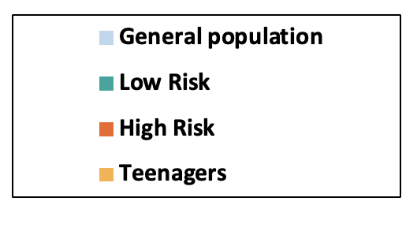
Existing comorbidities are distributed differently across the subgroups
Data as per April 20th, 2023
Co-morbidities at enrollment
13.9% of all mothers
13.5% of low-risk mothers
20.6% of high-risk mothers
12.9 % of teenage mothers

Slide 18

Outcomes vary between subgroups
Data as per April 20th, 2023
Data sources
2386 end of journey calls
19.120 billing records

Slide 19

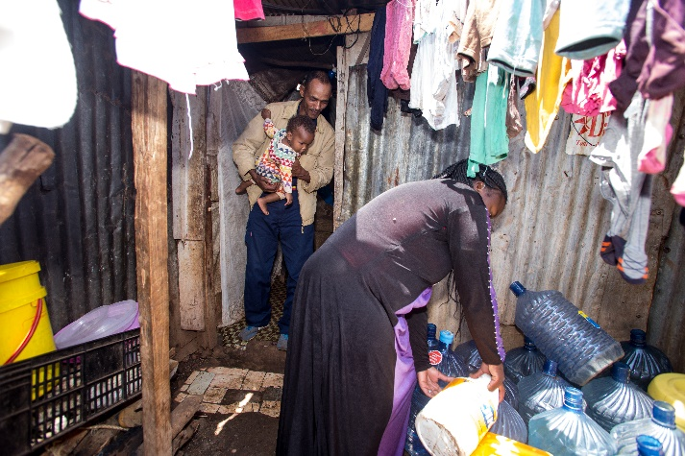
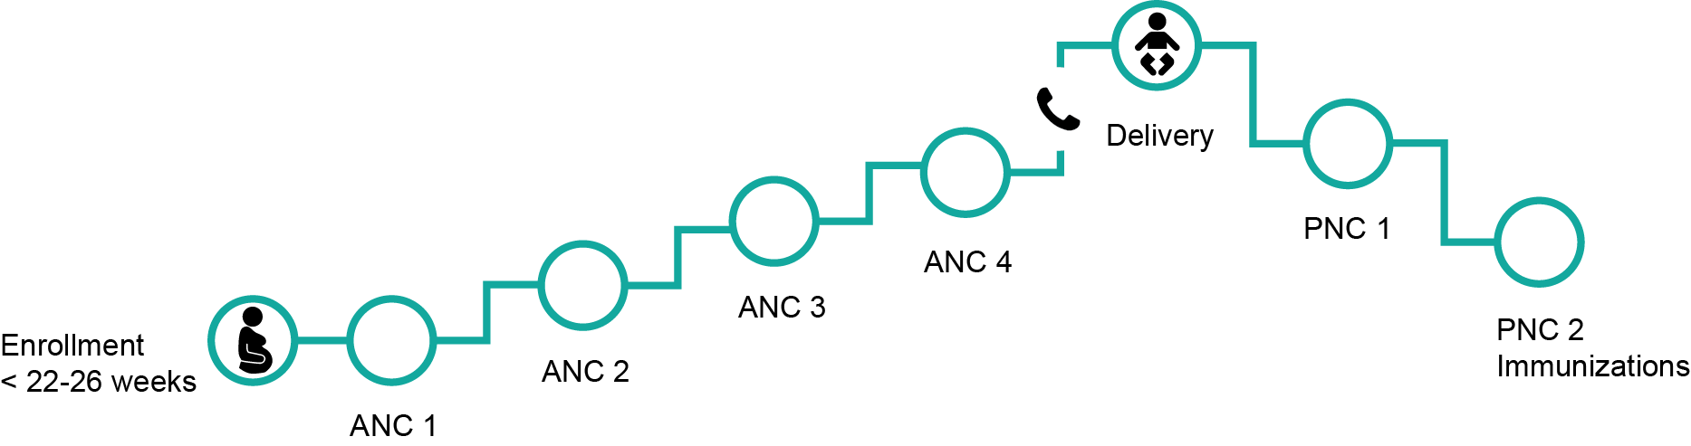
Low-Risk Mothers
Note: Realistic, but fictional patient profiles (for privacy reasons)
88-92 % low-risk mothers
Mary, a 30-year-old, has 2 children
Enrolled early at 12 weeks
She has had no previous pregnancy complications
She has a stable marriage and currently sells water bottles at the bus stops; all her children are healthy
17%
increase in # ANC
15%
increase in % ANC profile

Slide 20


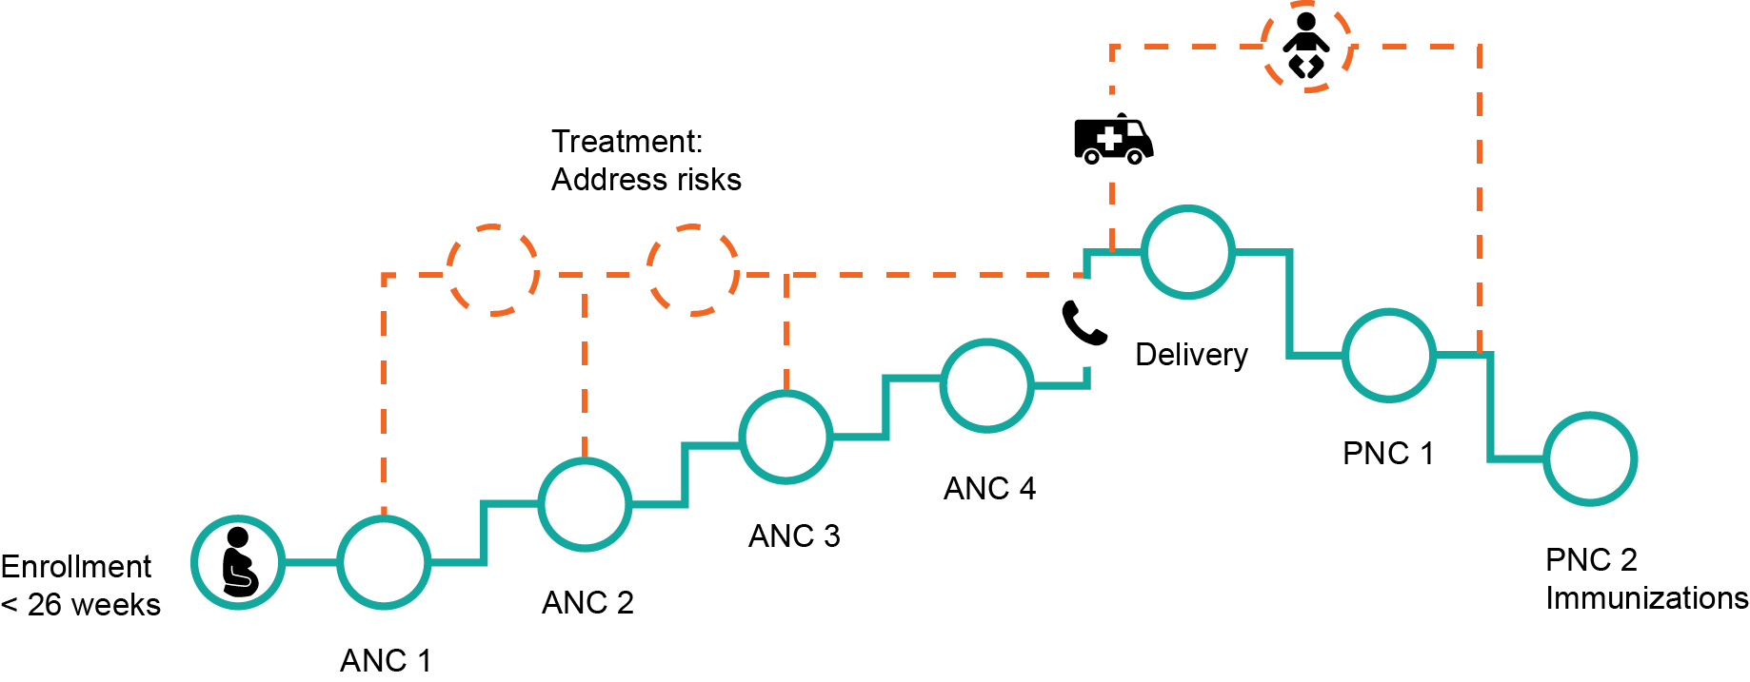
High-Risk Mothers
Note: Realistic, but fictional patient profiles (for privacy reasons)
8-12 % high-risk mothers
Change persona
Faith, a 35-year-old, has 1 child
History of miscarriage, antepartum haemorrhage and Malaria
She has a stable marriage, but her husband is often away for long periods to work
She is very anxious about this pregnancy and enrolled early
-
# of ANCS stable
25%
increase in % ANC profile

Slide 21
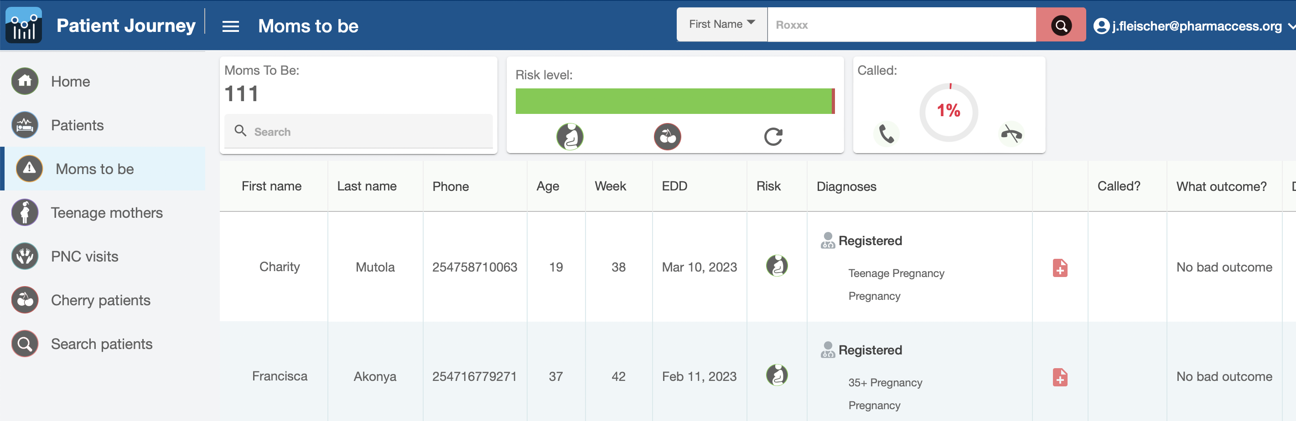
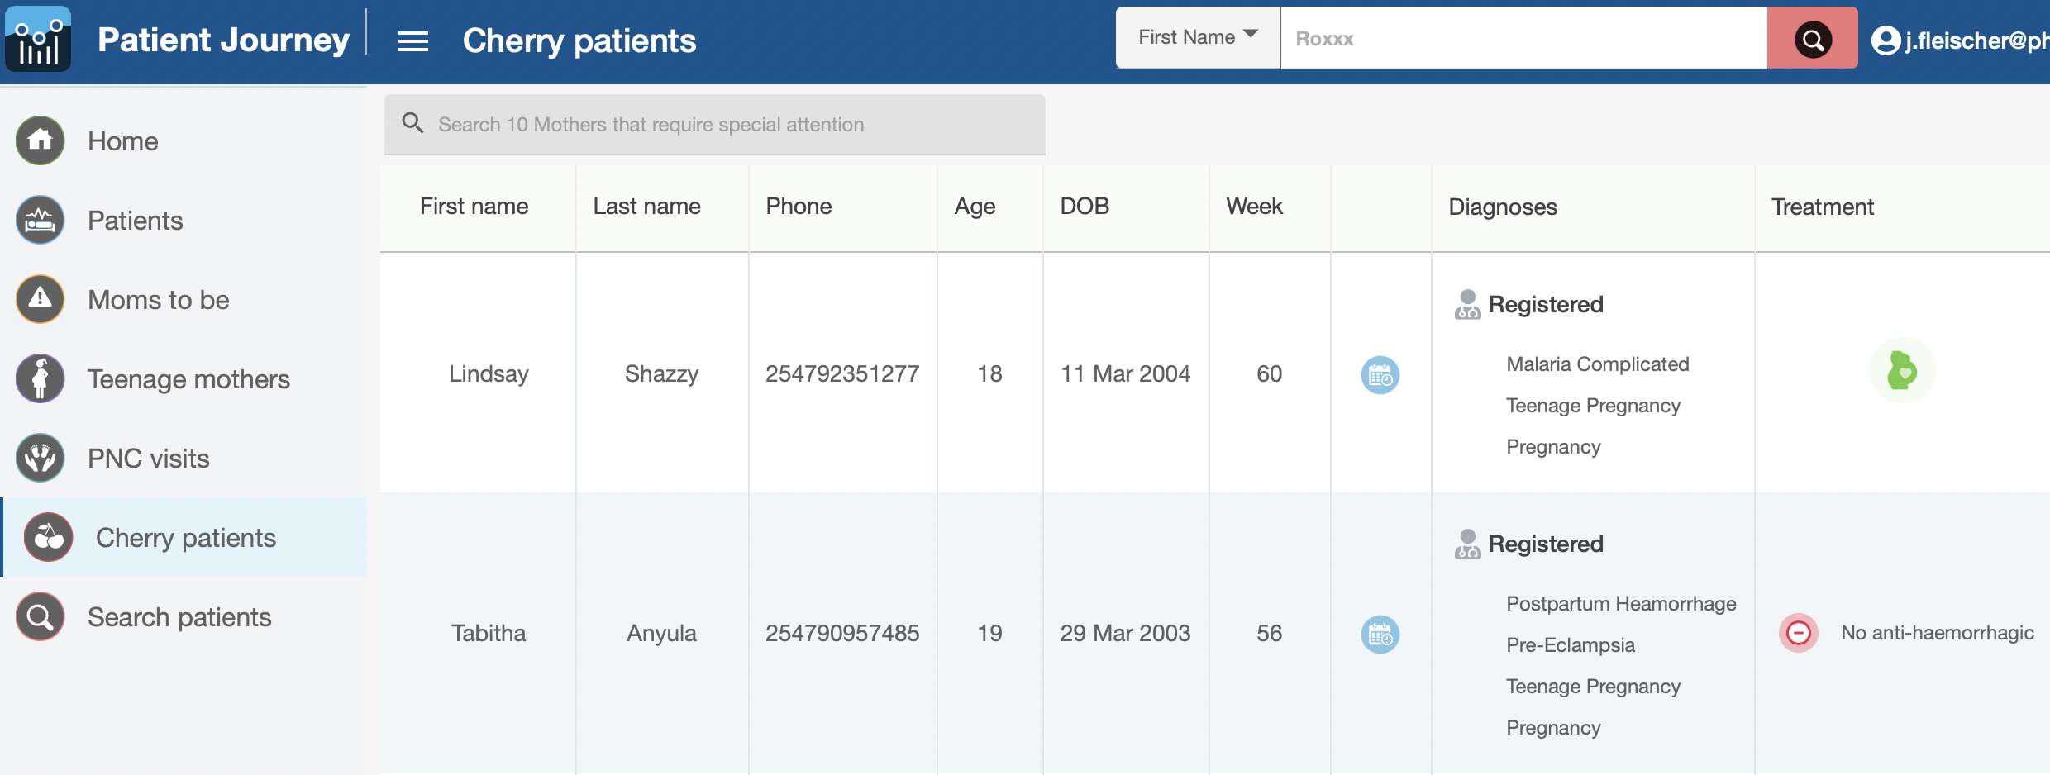
MomCare digital tools support medical staff for high-risk mothers
Care Bundle | Payments | Insights | Nudges
Moms2Be calls
Outcomes data collection
Journey quality assessment
Risk stratification
Test & Treat flagged cases
Pre-delivery filter lists
21

Slide 22
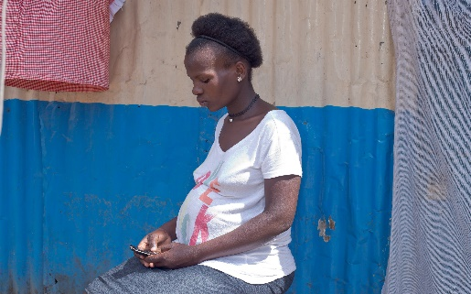

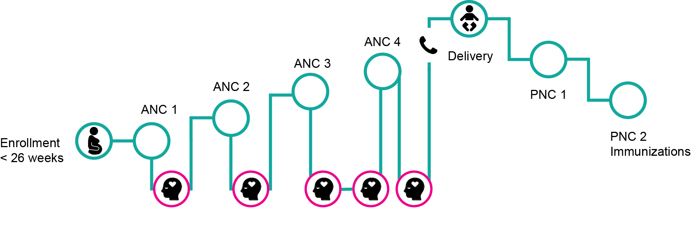
Mothers at risk for perinatal depression
Note: Realistic, but fictional patient profiles (for privacy reasons)
10 % with low mental health score
Susan, a 22-year-old, first child
2 ANC’s, 2 ultrasounds, counselling
Caesarean section
Treatment for recurrent urinary tract infection
Healthy baby
“Empower me on how to embrace this new motherhood season without fear Counseling to stop me from getting depressed”
Group-based mental health intervention was acceptable and seems to improve mental health and in-network delivery

Slide 23

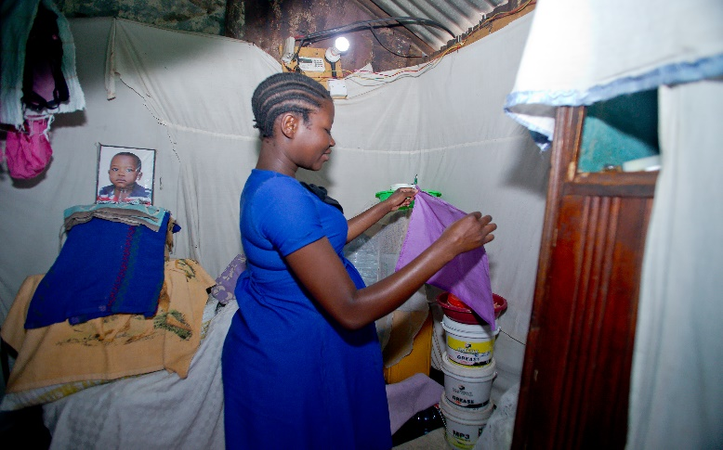

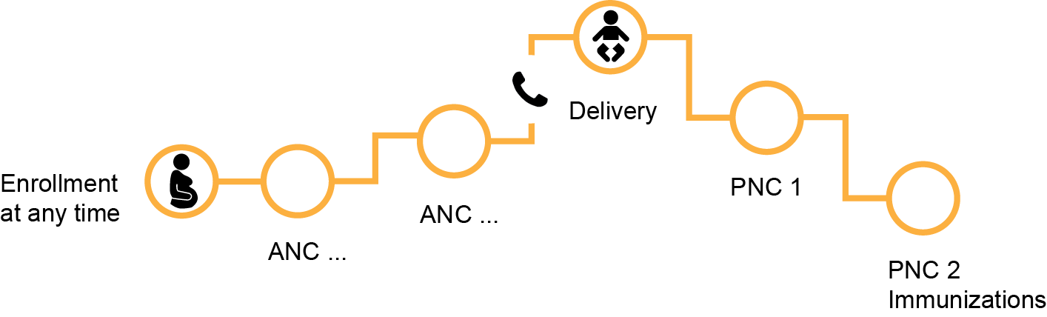
Teenage Mothers (<19)
Note: Realistic, but fictional patient profiles (for privacy reason)s
* Analysis on all mothers <20
12.4 % teenage mothers
Tabitha, 17-year-old, first child
She enrolled late at 34 weeks and was diagnosed with HIV and Malaria
She is currently a high school student but has not been attending classes due to stigma
She is estranged from her parents, and currently lives with her grandmother who does not earn an income
21%
increase in # ANC*
18%
increase in % ANC profile*

Slide 24
Next Steps
Ongoing research
Regression analysis on >55.000 journeys with ~3000 high quality patient-reported end of journey calls and ongoing data collection. Some factors of interest
Poverty
Existing co-morbidity
Maternal literacy & household education level
Clinic quality
Social support
Region
Care usage
Age > 35
Next steps
Maternity Care
Open data platform
VBC Diabetes Pilot in Ghana

Slide 25
Thank you.
Femke Heddema, 14/03/2023

Slide 26
Questions?
Julie Fleischer – Manager Value Based Care
j.fleischer@pharmaccess.org
26

